Slide 1
[BigData] 08 Auto-encoders and Generative Adversarial Networks
Jen-Wei Huang 黃仁暐
Department of Electrical Engineering, NCKU

Slide 2
Auto-encoder

Slide 3
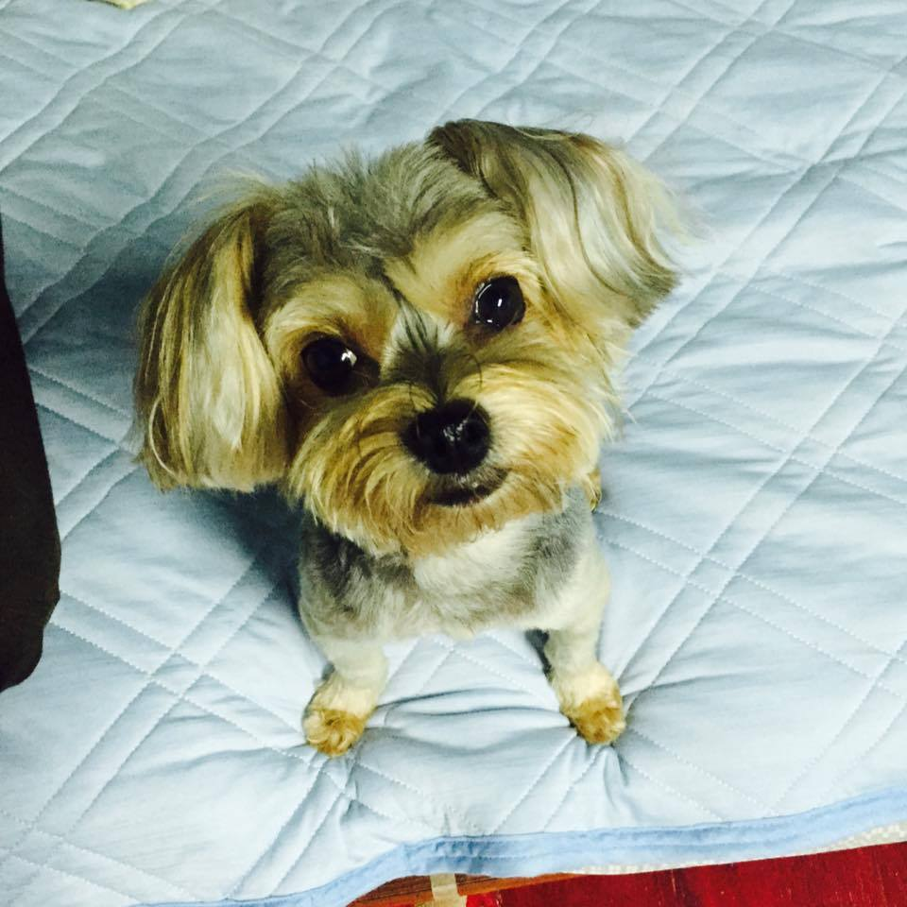
What are Auto-encoders
Learn the latent representation for the input
Encoder
Representation

Slide 4
How to Check the Code
Need a decoder to reconstruct the object by the latent representations
Representation
Decoder

Slide 5
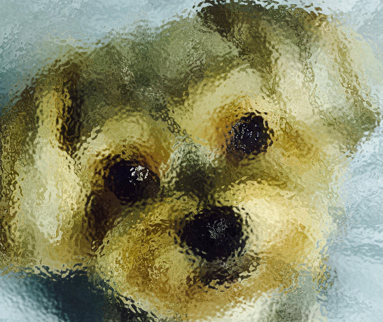
The Goal of Auto-encoders
Check if the reconstructed object is similar to the original one
Encoder
Decoder
？
Representation

Slide 6
The Goals of Encoders and Decoders
Encoder
Make the latent representation approximately represent the object
Build the representation for data
Decoder
Make the latent representation approximately reconstruct the object
Generate data from the representation

Slide 7
How to Train Auto-encoders
The auto-encoders can be treated as a DNN
Input is a vector
Output is a vector with the same dimension as the input
Errors are the differences between inputs and outputs

Slide 8
How to Train Auto-encoders
The difference between
Inputs and outputs
Representation

Slide 9
Auto-encoder by CNN
Input
Unpooling
Deconvolution
Unpooling
Deconvolution
Convolution
Pooling
Convolution
Pooling
Output

Slide 10
Unpooling
pooling
0.1 | 0.7 | 1.5 | 0.1
-0.3 | 0.5 | 0.2 | -0.7
0.4 | 0.9 | 0.3 | 0.6
0.8 | -0.1 | 2.1 | 0.8
0.7 | 1.5
0.9 | 2.1
0 | 1 | 1 | 0
0 | 0 | 0 | 0
0 | 1 | 0 | 0
0 | 0 | 1 | 0
unpooling
0 | 0.7 | 1.5 | 0
0 | 0 | 0 | 0
0 | 0.9 | 0 | 0
0 | 0 | 2.1 | 0
The pooling position
0.7 | 1.5
0.9 | 2.1

Slide 11
Deconvolution
Convolution
Deconvolution

Slide 12
Using Convolution to Do Deconvolution

Slide 13
Pre-trained DNN as Auto-encoders
The target auto-encoder
‧
‧
‧
‧
‧
‧
‧
‧
‧
700
1000
1000
500
100
20
1st training
2nd training
‧
‧
‧
‧
‧
‧
‧
‧
‧
‧
‧
‧
‧
‧
‧
‧
‧
‧
700
1000
700
700
1000
1000
1000

Slide 14
Pre-trained DNN as Auto-encoder
The target auto-encoder
‧
‧
‧
‧
‧
‧
‧
‧
‧
700
1000
1000
500
100
20
3rd training
4th training
‧
‧
‧
‧
‧
‧
‧
‧
‧
‧
‧
‧
‧
‧
‧
‧
‧
700
1000
1000
500
1000
1000
500
100
500

Slide 15
Pre-trained DNN as Auto-encoders
The target auto-encoder
‧
‧
‧
‧
‧
‧
‧
‧
‧
700
1000
1000
500
100
20
5th training
‧
‧
‧
‧
‧
‧
‧
‧
‧
700
1000
1000
500
100
20
Fine tune the weights

Slide 16
How to Design a Good Auto-encoder

Slide 17
The Hyper Parameters
The layers of encoder and decoder
The dimensions of each layer
The dimensions of the code should be lower than the input
Pre-train or not

Slide 18
The Most Important One
If the dimension of hidden layers is higher than the input layer
Need some regularizations to make sure the sparsity of the hidden layer
0
3
2
5
4
1
0
0
0
0
2
0
3
0
1
0
3
2
5
4
1
3
2
5
4
1
Nothing be
trained
Something
be trained

Slide 19
Generative Adversarial Network

Slide 20
The Creation of NNs
Traditional NNs is a supervised learning model
Learn knowledge from labeled data
The knowledge is based on the label
Cannot have some creativity
How about creating data by machine?
Auto-encoder
The decoder in auto-encoder

Slide 21
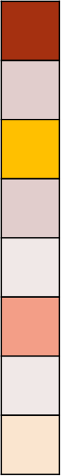

The Generator in GANs
Generator
(G)
Representation code

Slide 22
Is Generated Data Real Enough?
Discriminator
Used to distinguish the true input object from the generated fake one
The goal of G is to confuse the discriminator
Discriminator
(D)
Is the dog real or not？

Slide 23
A Brief Overview of GANs
Generator
(G)
Discriminator
(D)
Is the dog
real or not？

Slide 24
The Training Objective
Generator
Generate the object very close to the real object
Discriminator
Correctly distinguish the true or fake objects

Slide 25

The Training Process of GANs
Fake Object
Real Object
Generator
V1
Discriminator
V1
The image is too fake

Slide 26
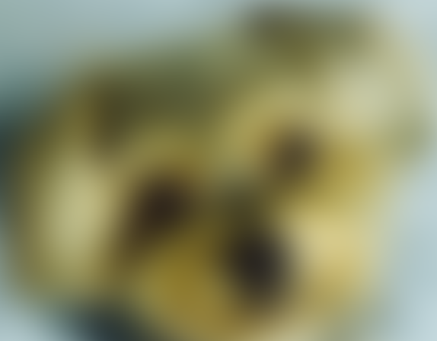
The Training Process of GANs
Generate more
objects
Generator
V2
Update the
discriminator
Discriminator
V1

Slide 27
The Training Process of GANs
Fake Object
Real Object
Generator
V2
Discriminator
V2
The image is too fake

Slide 28

The Training Process of GANs
Generate more
real objects
Repeat
many turns
Generator
Update the
discriminator
Discriminator
The image is too fake

Slide 29
How to Train GANs
For every iteration
We train the discriminator first
By a given generator
Do many rounds to create a powerful discriminator
Then we train the generator
By a given discriminator
Only one iteration to prevent overfitting

Slide 30
Training On Discriminators
The discriminator is a binary classifier
Classify if the input is real or not
Use cross-entropy as the error of the discriminator
Back-propagation to train discriminator
Lower cross-entropy is better

Slide 31
Training On Generators
The goal of generator is to generate the data close to the real data
Let discriminator unable to classify the real objects well
Using the cross-entropy of the discriminator as the error
Back-propagation to train the generators
Higher cross-entropy is better

Slide 32
In Practice
We will use reverse KL-divergence instead of KL-divergence
To make the training faster

Slide 33
The Problems in GANs
The balance between generator and discriminator
Mode collapse
Gradient vanishing

Slide 34
Mode Collapse
We hope that
In real case
Generated distribution
Generated distribution
Real distribution
Real distribution

Slide 35
Mode Collapse
Do not generate different kinds of objects
Will lead KL or JS divergence larger
The loss will be larger
Tend to generate the same real objects
Will lead the smallest loss
The generated object is very similar
Loss the diversity of the objects

Slide 36
Another Example for Mode Collapse
Real distribution
Ideal generated distribution

Slide 37
Another Example for Mode Collapse
Actually……
100th iteration
500th iteration
An infinite loop……
Cannot converge
1000th iteration
1500th iteration

Slide 38
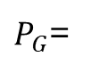
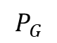
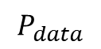
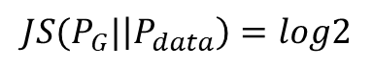
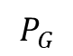
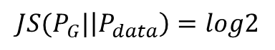
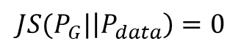
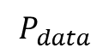
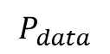
Gradient Vanishing
1st iteration
$$P_{G}$$
$$P_{data}$$
$$JS(P_{G}|\left|P_{data}\right)=log2$$
Not become better
50th iteration
$$P_{G}$$
$$P_{data}$$
$$JS(P_{G}|\left|P_{data}\right)=log2$$
Too fast and hard
100th iteration
$P_{G}$=
$$P_{data}$$
$$JS(P_{G}|\left|P_{data}\right)=0$$

Slide 39
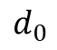
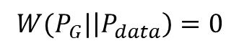
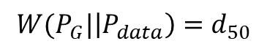
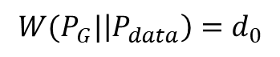
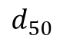
If We Change The Distance Measurement?
1st iteration
$$P_{G}$$
$$P_{data}$$
$$d_{0}$$
$$W(P_{G}|\left|P_{data}\right)=d_{0}$$
50th iteration
$$P_{G}$$
$$P_{data}$$
$$d_{50}$$
$$W(P_{G}|\left|P_{data}\right)=d_{50}$$
100th iteration
$P_{G}$=
$$P_{data}$$
$$W(P_{G}|\left|P_{data}\right)=0$$

Slide 40
Wasserstein Distance
Also known as Earth Mover Distance
The distance from a distribution to another distribution
More simplify：
Two distributions are places
There is a pile of earth on the first distribution
We want to move the earth to the second distribution
The average distance is Earth Mover Distance

Slide 41
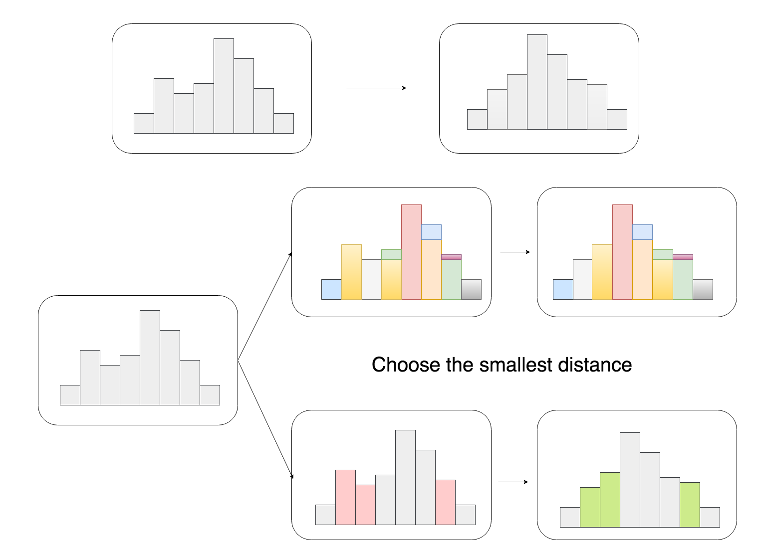
Earth Mover Distance

Slide 42
Wasserstein Generative Adversarial Network (WGAN)
Using Wasserstein distance instead of KL divergence or JS divergence
Can solve the problems on GAN
The balance on generator and discriminator
Mode collapse
Gradient vanishing

Slide 43
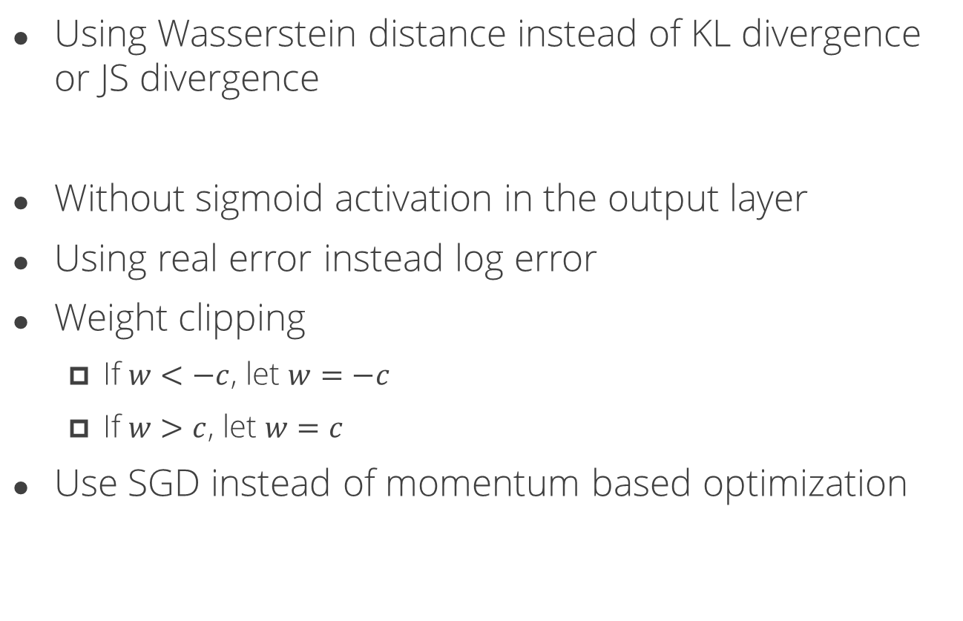
The Modifications in WGAN
Using Wasserstein distance instead of KL divergence or JS divergence
Without sigmoid activation in the output layer
Using real error instead log error
Weight clipping
If $w<−c$, let $w=−c$
If $w>c$, let $w=c$
Use SGD instead of momentum based optimization

Slide 44
How to Design a Good GAN

Slide 45
The Notions and Suggestions
The performance of generator and discriminator
The discriminator should not be very strong
The diversity of inputs and outputs
Especially the diversity of outputs
To prevent mode collapse
Consider to use WGAN instead of GANs
Prevent the problems in GANs

Slide 46

Thank you for your listening
Knowledge and Information Discovery Lab
http://kid.ee.ncku.edu.tw

